Slide 1


Revenue Structure, Geographic Exposure & Risk Review – 2024
Executive FP&A Assessment
President & Steering Committee
| FRANCISCO TORREALBA A.

Slide 2


EXECUTIVE SNAPSHOT – REVENUE & EXPOSURE
Total Revenue
$2.12B
LatAm Revenue
$293.1M (13.8%)
Q4 Risk Exposure
$9.9M (1.49%)
Top 10 Concentration
1.02%

Slide 3
LatAm Revenue – Concentration & Opportunity
Peru generates almost double the revenue of its closest peers.

Slide 4
Q4 2024 Revenue – Risk Countries
REVENUE IN USD FROM CHINA & VENEZUELA ONLY REPRESENTS 1.5% OF TOTAL REVENUE FOR Q4

Slide 5
MARKET SECTION PERFORMANCE
Differences by Market Section
Revenue expectations differ structurally by section
Section 2 clients had the highest average transaction value.
Section 1 clients had lower average ticket sizes.
NonNumeric section (legacy or undefined IDs) represented the largest total volume and revenue simply due to scale.
Transaction count per section was not drastically different — the difference came from average ticket size.
In other words: Section explains revenue differences more through pricing structure and client profile, not volume concentration.

Slide 6
REVENUE NOT MATERIALLY IMPACTED
Differences by Geography
Revenue highly diversified globally.
LatAm contributes meaningfully but not disproportionately.
Peru has similar transaction volume to peers but significantly higher revenue. Meaning: higher average transaction size.
Risk countries represent only 1.49% of Q4 revenue.
No structural geographic concentration risk identified.
Economic strength (GDP, financial system maturity) likely influences transaction value.

Slide 7
Operating at the intersection of risk, strategy, and people, we partner with our clients to address their complex challenges.
Our approach is unique in the industry.
That’s THE MMC ADVANTAGE.
STRATEGIC RECOMMENDATIONS
Maintain diversified revenue structure.
Expand selectively in high-efficiency markets (Peru).
Conduct elasticity testing before price increases.
Continue monitoring regulatory risk exposure.
Develop section-specific growth strategy.
RISK
STRATEGY
THE MMC ADVANTAGE
PEOPLE

Slide 8



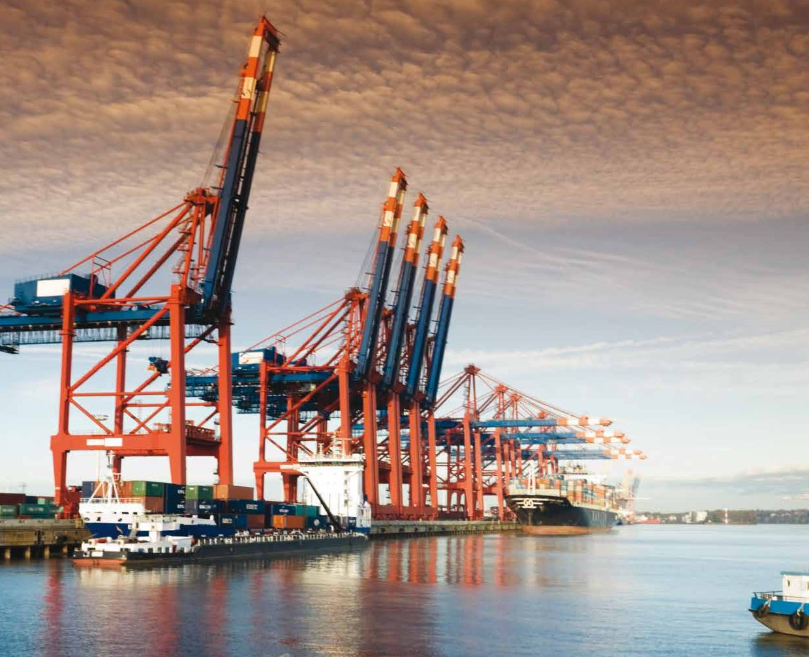






VERSION: 2.3.2026

